Slide 1
SEARCHING ALGORITHMS
BHAVANA
DAY 9
15/04/2024

Slide 2
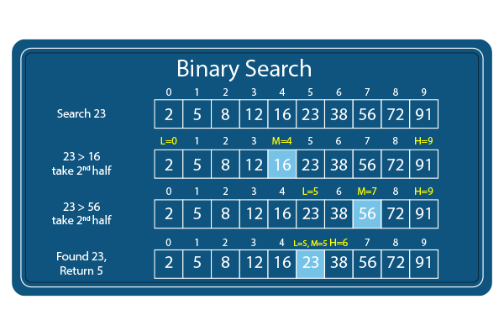
BINARY SEARCH:

Slide 3
Binary_Search(a, lower_bound, upper_bound, val) // 'a' is the given array, 'lower_bound' is the index of the first array element, 'upper_bound' is the index of the last array element, 'val' is the value to search
Step 1: set beg = lower_bound, end = upper_bound, pos = - 1
Step 2: repeat steps 3 and 4 while beg <=end
Step 3: set mid = (beg + end)/2
Step 4: if a[mid] = val
set pos = mid
print pos
go to step 6
else if a[mid] > val
set end = mid - 1
else
set beg = mid + 1
[end of if]
[end of loop]
Step 5: if pos = -1
print "value is not present in the array"
[end of if]
Step 6: exit

Slide 4
JUMP SEARCH:
Step 1 − If the size of the input array is ‘n’, then the size of the block is √n. Set i = 0.
Step 2 − The key to be searched is compared with the ith element of the array. If it is a match, the position of the element is returned; otherwise i is incremented with the block size.
Step 3 − The Step 2 is repeated until the ith element is greater than the key element.
Step 4 − Now, the element is figured to be in the previous block, since the input array is sorted. Therefore, linear search is applied on that block to find the element.
Step 5 − If the element is found, the position is returned. If the element is not found, unsuccessful search is prompted.

Slide 5
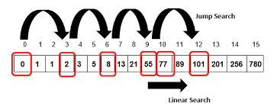

Slide 6
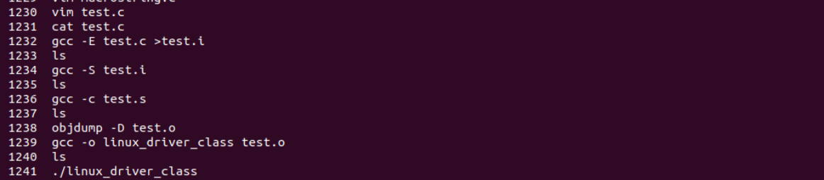
DEBUGGING CODE:

Slide 7


